Slide 1
Chemistry – Aug 13, 2019 – Triplett Rm 210
Welcome to Chemistry!! Sit anywhere for today.
Student Handbook (1st Per p4-6, 2nd Per p7-8, 8th Per p18)
Let’s find out about YOU, ME, US….How?...Why?
Four Dimensions Measured:
Introvert (I) – Extrovert (E) Sensing (S) – Intuitive (N)
Thinking (T) – Feeling (F) Perceiving (P) – Judging (J)

Slide 2
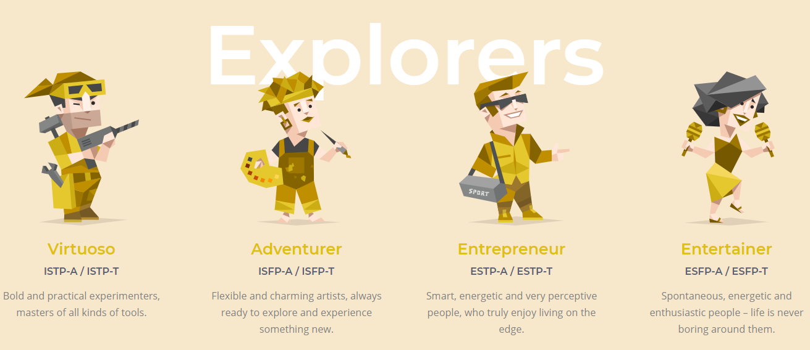
The Explorers (*S*P)

Slide 3
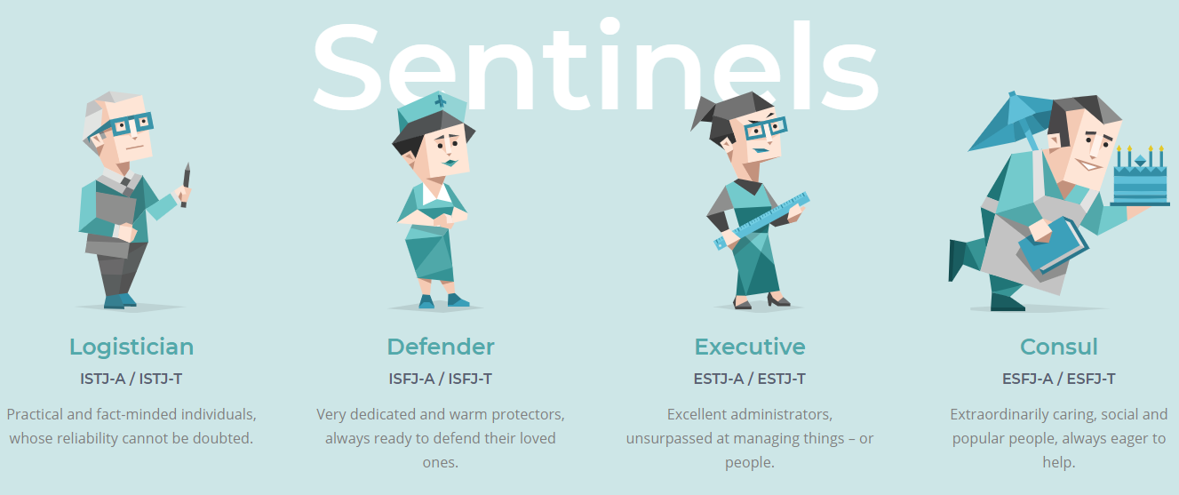
The Sentinels (*S*J)

Slide 4
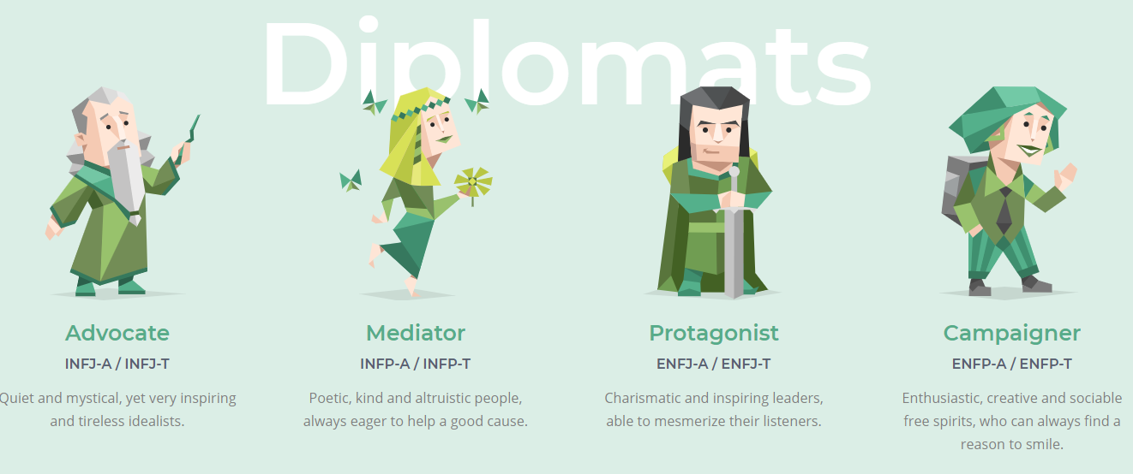
The Diplomats (*NF*)

Slide 5
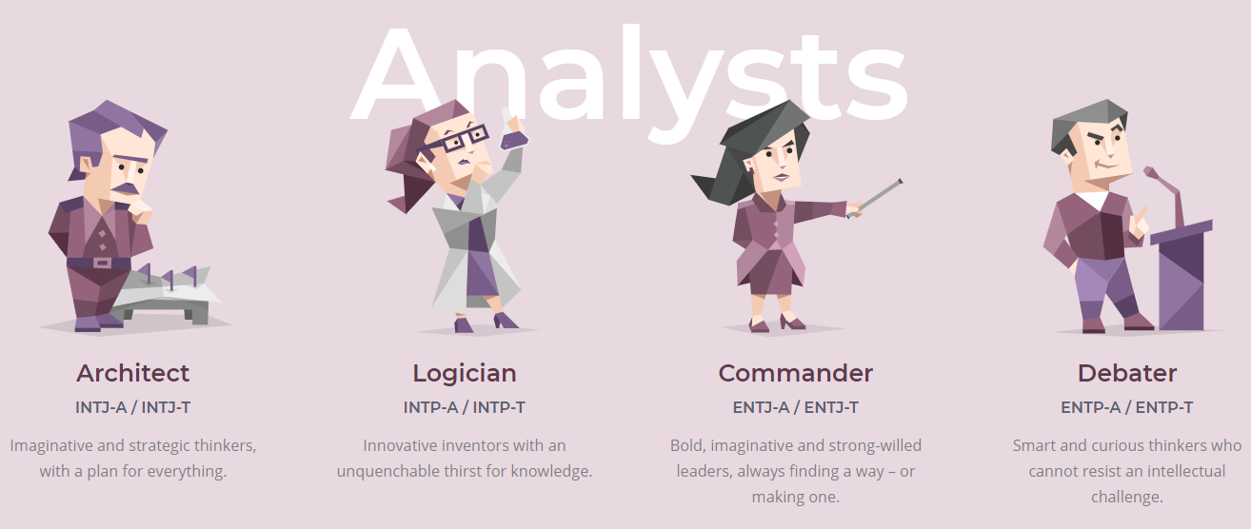
The Analysts (*NT*)

Slide 6
What to do…
Check out https://www.16personalities.com/
Determine your type by taking their quiz (10 min)
Pick up a copy of your type’s learning style information
Survey classmates. Try to find at least one representative for each of the 16 personalities.
Identify your type on the teacher’s survey sheet by signing your name.
Line ups (time permitting)

Slide 7
Homework
Visit our class website.
Download the syllabus. Print and bring to next class.
(2 pt assignment) Show me the syllabus hardcopy or digital for credit.
Complete the Syllabus Verification Form Signed by a parent and you.
Determine Albert’s Life Lesson for August (#1)
https://www.slps.org/Page/33378

